Slide 1

Esser County Education: FEV Tutor Impact Analysis 2022-2023
March 12,2024

Slide 2
Data visuals
Agenda
Bridging current challenges to future success of problem statement
Key findings & Insights
Recommendations for contract renewal
Additional data points

Slide 3










Bridging Current Challenges to Future Success of problem statement
Current State
Future desired state
Stakeholders and their responsibility:
Esser country department of education is responsible for overseeing the education system and implementing strategies for academic improvement
Current scenario:
A thorough reassessment of the data is required as the initial analysis conducted by team indicated a negative impact on end-of-year benchmark results
Expectations:
The client expects insights and recommendations from analysis to address the challenges in academic improvement with actionable strategies focusing on students performance growth
Outcomes:
The X% positive growth in student benchmark outcomes will be achieved after the reassessment of data
Business actions:
Tailored Interventions: Developing personalized tutoring plans based on student needs and performance data
Continuous Monitoring: Implementing a robust monitoring and evaluation system to track progress and adjust strategies as needed
Business outputs:
Providing actionable recommendations for enhancing the partnership with FEV tutor and addressing educational challenges.
Bridging the gap
Lack of a comprehensive system for tailored interventions and continuous monitoring, crucial for improving academic performance and strengthening the partnership between FEV tutor and Esser county department of education.
Data analysis process
Collection of data
Data preprocessing
Tools
ML Algorithm
Insights & recommendations
Power BI dashboard
Story boarding

Slide 4

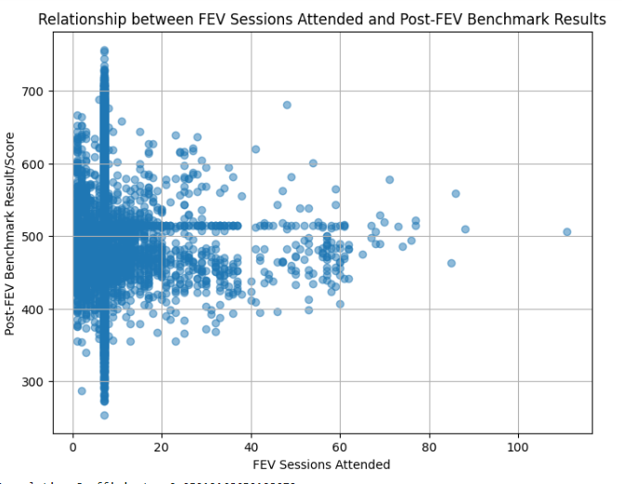
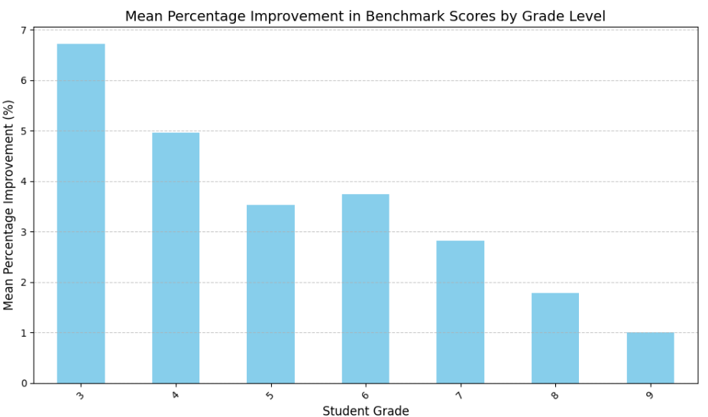
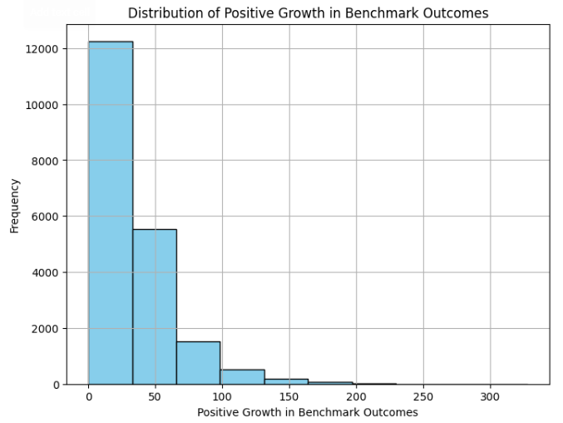
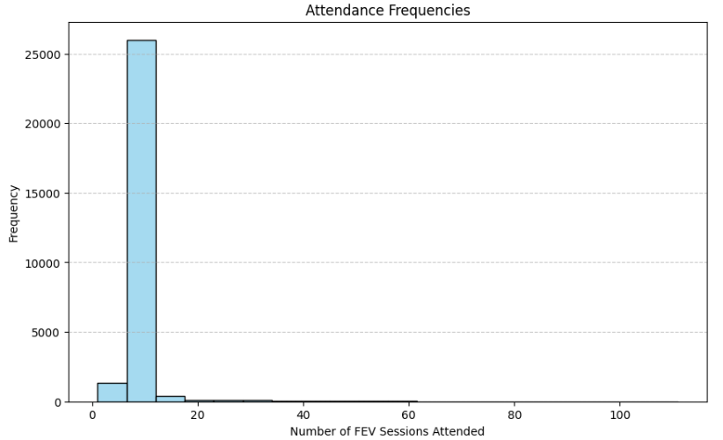
Data Visuals
Scatterplot showcases the increased participation in FEV sessions positively correlates with higher post-FEV benchmark results, suggesting a promising avenue for enhancing student outcomes
Illustrates that grade 3 students exhibit strong academic performance, indicating a positive overall influence of the tutoring program across various grade levels
It lustrates a direct correlation between the frequency of FEV tutoring sessions attended and the growth of student outcomes, suggesting that increased session attendance leads to enhanced academic performance
Depicts the positive impact of the reassessment of data on student benchmark outcomes.

Slide 5




Key findings &Insights
01
02
03
04
Third-grade students might have established a solid groundwork in fundamental academic abilities during prior grades, positioning them for success in subsequent years due to a higher number of students.
The one-on-one / small group instruction, allowing tutors to tailor their approach to meet the specific needs of each student
Increased student engagement, coupled with the integration of technology previously unfamiliar to students, likely contributed to the improvement of positive growth in student benchmark outcomes.
FEV sessions offered personalized instruction based on each student's learning style, pace, and preferences.

Slide 6









Recommendations for contract renewal
Recommendations:
Value-Added Services:
Introducing value-added services such as academic counseling, college readiness workshops, or parent engagement sessions to provide comprehensive support for student academic success
Stakeholder Engagement Forums:
Host regular stakeholder engagement forums to solicit feedback from parents, students, educators, and community members, fostering transparency, accountability, and collective ownership of the tutoring program's success.
Performance-Based Contracting:
Consider transitioning to a performance-based contracting model, where FEV Tutor's compensation is tied to predefined student outcome metrics, incentivizing accountability and ensuring alignment with district goals.
Technology Integration:
Leverage technology to enhance tutoring delivery, offering interactive learning platforms, virtual classrooms, or adaptive learning technologies to engage students, personalize instruction, and optimize learning outcomes
Feedback and Continuous Improvement:
Establish mechanisms for collecting feedback from students, parents, and educators to continuously refine and improve tutoring services, ensuring responsiveness to evolving needs and preferences
Additional data points :
Student Demographics:
Understanding the socioeconomic status, gender distribution, and regional disparities among students can help tailor tutoring strategies to address specific needs and barriers to learning, thereby promoting equitable access to educational support and improving overall student outcomes
Session Attendance Rates:
Higher session attendance rates are likely to correlate with improved student performance, indicating active participation and engagement in the tutoring program, which can lead to positive growth in benchmark outcomes after the reassessment of data
Duration of Tutoring Sessions:
Longer duration of tutoring sessions may allow for more in-depth instruction and targeted support, potentially resulting in greater academic gains and advancements in student benchmark outcomes following the reassessment of data
Student Engagement Levels:
Monitoring student engagement levels during tutoring sessions provides insights into their level of involvement, interest, and motivation, which are key determinants of learning success.

